Slide 1
Introduction to Computer Vision(CS708)
Lecture01 - Introduction
Dr. Abdul Basit
Assistant Professor - CSIT University of Balochistan
May 15, 2024
Intro to Computer Vision - Lec01: Introduction

Slide 2
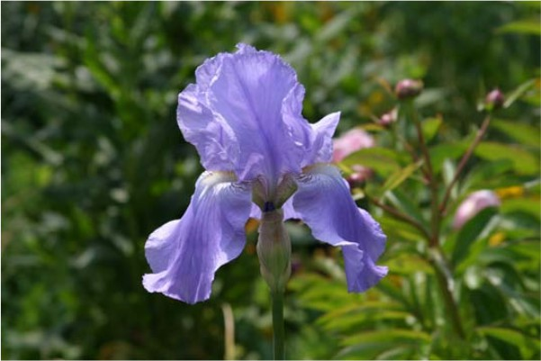
Introduction
Vision systems
Figure: The human visual system has no problem interpreting the subtle variations in translucency and shading in this photograph and correctly segmenting the object from its background..
Intro to Computer Vision - Lec01: Introduction

Slide 3
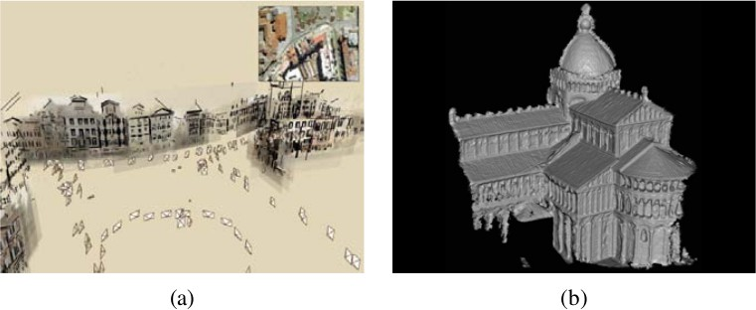
Introduction
Vision algorithms and application.
Figure: (a) Structure from motion algorithms can reconstruct a 3D point model of a large complex scene from hundreds of partially overlapping photographs (b) Stereo matching algorithms can build a detailed 3D model of a building facade from hundreds of differently exposed photographs taken from the Internet.
Intro to Computer Vision - Lec01: Introduction

Slide 4
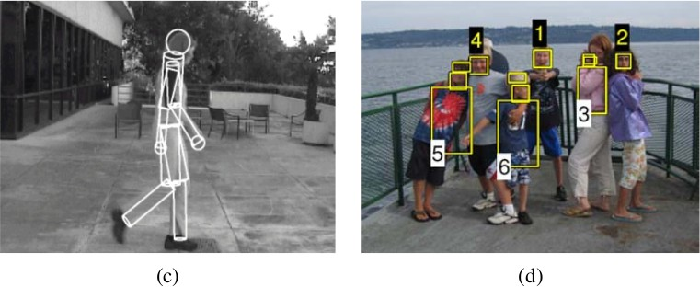
Introduction
Vision algorithms and application.
Figure: (c) Person tracking algorithms can track a person walking. (d) In front of a cluttered background, Face detection algorithms, coupled with color-based clothing and hair detection algorithms, can locate and recognize the individuals in this image.
Intro to Computer Vision - Lec01: Introduction

Slide 5



Contents
1 What is computer vision?
2
Applications
3 About course
Software used Marks distribution Readings
Intro to Computer Vision - Lec01: Introduction

Slide 6
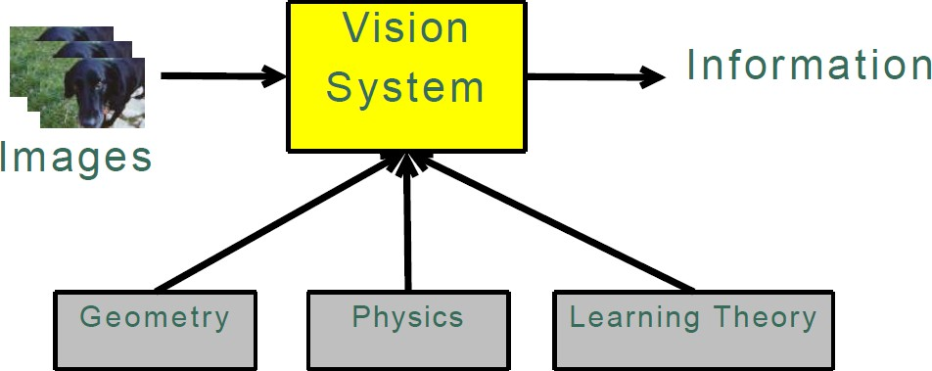
Introduction
Vision systems
Figure: Source: Dr. Matthew
This kind of information we want is application specific: 3D models
Object poses Object categories Camera poses
Intro to Computer Vision - Lec01: Introduction

Slide 7
Introduction
Parts of system
The “vision system” includes Image acquisition hardware
Analog camera plus digital frame grabber, -or-
Digital camera with a fast serial interface (Firewire, USB, etc.)
Image processing support software Your computer vision algorithms
Intro to Computer Vision - Lec01: Introduction

Slide 8


Contents
1 What is computer vision?
2
Applications
3 About course
Software used Marks distribution Readings
Intro to Computer Vision - Lec01: Introduction

Slide 9
Introduction
Application
Important application include
Optical character recognition (OCR) Industrial inspection and control Mobile robot navigation
Military intelligence Security (Surveillance)
Fingerprint recognition and biometrics Image retrieval from digital libraries Medical image analysis
3D model capture for visualization and animation
Intro to Computer Vision - Lec01: Introduction

Slide 10
Introduction
Broader consumer-level applications
Important broader consumer-level applications include Stitching
3D modeling Face detection
Visual authentication Morphing
Exposure bracketing Photo based walkthroughs
Intro to Computer Vision - Lec01: Introduction

Slide 11
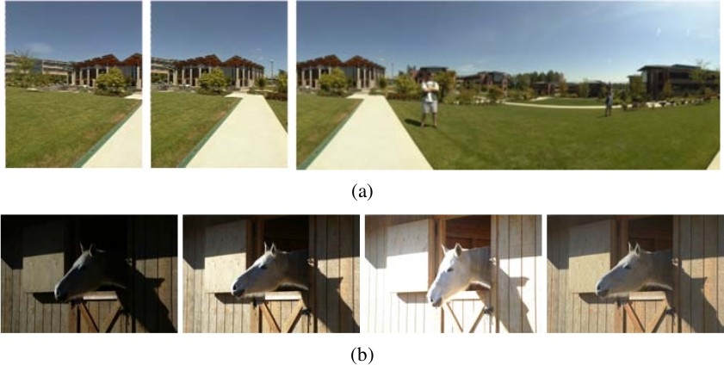
Introduction
Vision systems
Figure: (a) image stitching: merging different views. (b) exposure breacketing: merging different exposures.
Intro to Computer Vision - Lec01: Introduction

Slide 12
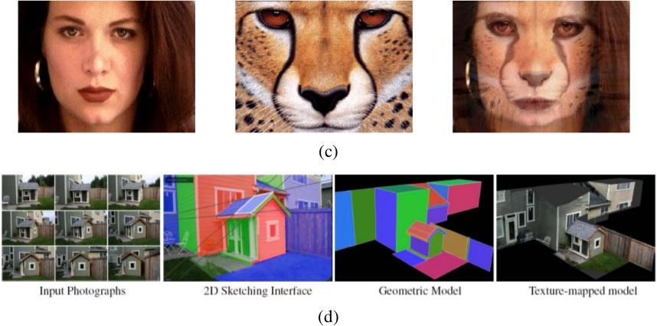
Introduction
Vision systems
Figure: (c) morphing: blending between two photographs. (d) turning a collection of photographs into a 3D model.
Intro to Computer Vision - Lec01: Introduction

Slide 13

Contents
1 What is computer vision?
2
Applications
3 About course
Software used Marks distribution Readings
Intro to Computer Vision - Lec01: Introduction
13 / 18

Slide 14
Contents
1 What is computer vision?
2
Applications
3 About course
Software used Marks distribution Readings
Intro to Computer Vision - Lec01: Introduction
13 / 18

Slide 15
Course
Software used
The software used during the course Python 3.x
OpenCV Libraries
Intro to Computer Vision - Lec01: Introduction
14 / 18

Slide 16
Contents
1 What is computer vision?
2
Applications
3 About course
Software used Marks distribution Readings
Intro to Computer Vision - Lec01: Introduction
14 / 18

Slide 17
Course
Marks distribution
Marks distribution Mid-term Terminal
(30%)
(40%)
Assignments and Quizzes (15%) Research Report (15%)
Intro to Computer Vision - Lec01: Introduction
15 / 18

Slide 18
Contents
1 What is computer vision?
2
Applications
3 About course
Software used Marks distribution Readings
Intro to Computer Vision - Lec01: Introduction
15 / 18

Slide 19
Introduction
Software used
Textbooks and resources used in this course
Computer Vision: Algorithms and Applications by Richard Szeliski
Introduction to Computer Vision - CS143 Computer vision from Mubarak Shah
Intro to Computer Vision - Lec01: Introduction

Slide 20
Introduction
This semester
This semester we focus on algorithms for 3D reconstruction
Learning
Sequential state estimation (e.g. tracking)
To understand modern 3D reconstruction techniques we need to understand how cameras transduce the world into image.
This involves understanding projective geometry and camera models. Then we can begin to figure out how to invert what the camera does or reconstruct the 3D scene
Intro to Computer Vision - Lec01: Introduction

Slide 21
The End
21 / 21

